Slide 1
What are the different Configuration Sources available in the ASP.NET Core application?
If you have worked with the previous versions of the ASP.NET application, then you may know the importance of the web.config file. In previous versions , we generally used to store the application configuration settings such as database connection strings, any application scope global variables, and many more within the web.config file. But in ASP.NET Core, the application configuration settings can come from different configurations sources such as
Files (appsettings.json, appsettings.{Environment}.json, where the {Environment} is the nothing but the applications current hosting environments such as Development, Staging or Production)
User secrets
Environment variables
Command-line arguments

Slide 2
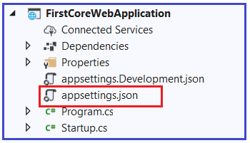
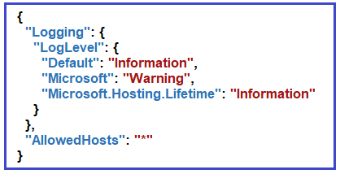
What is ASP.NET Core appsettings.json File?
When we create an ASP.NET Core Web application with an Empty project template or Razor Pages or MVC Template or Web API Template, then the visual studio automatically creates the appsettings.json file for us as shown in the below image.
The appsettings.json file is an application configuration file used to store configuration settings such as database connections strings, any application scope global variables, etc. If you open the ASP.NET Core appsettings.json file, then you see the following code by default which is created by visual studio.

Slide 3
Setting Key value pair
Now I am going to add a key with the name MyCustomKey within this file. To do so, please modify the appsettings.json file as shown below. As it is a JSON file, you need to store the value in the form of key-value pair.
{
"Logging": {
"LogLevel": {
"Default": "Information",
"Microsoft": "Warning",
"Microsoft.Hosting.Lifetime": "Information"
}
},
"AllowedHosts": "*",
"MyCustomKey": "MyCustomKey Value coming from appsettings.json"
}

Slide 4
How to access the configuration information in the ASP.NET Core application?
To access the configuration information within the Startup class, you need to use the service which is provided by the ASP.NET Core Framework.
Explanation of the above code:
using Microsoft.Extensions.Configuration;
namespace WebAppMVC
{
public class Program
{
public static void Main(string[] args)
{
var builder = WebApplication.CreateBuilder(args);
// Add services to the container.
builder.Services.AddControllersWithViews();
var app = builder.Build();
// Configure the HTTP request pipeline.
/* if (!app.Environment.IsDevelopment())
{
app.UseExceptionHandler("/Home/Error");
// The default HSTS value is 30 days. You may want to change this for production scenarios, see https://aka.ms/aspnetcore-hsts.
app.UseHsts();
}*/
// app.UseHttpsRedirection();
// app.UseStaticFiles();
//app.UseRouting();
//app.UseAuthorization();
ConfigurationManager configuration = builder.Configuration;
//Get the Value
//string MyCustomKeyValue = configuration.GetValue<string>("MyCustomKey");
string MyCustomKeyValue = configuration["MyCustomKey"];
app.UseRouting();
app.UseEndpoints(endpoints =>
{
endpoints.MapGet("/", async context =>
{
await context.Response.WriteAsync(MyCustomKeyValue);
});
});
app.Run();
}
}
}
The Map method Branches the request pipeline based on matches of the given request path. If the request path starts with the given path, the branch is executed else the Middleware simply ignored.

Slide 5
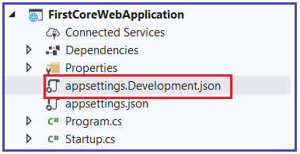
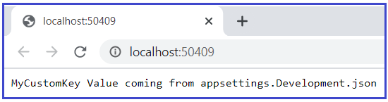
Dependency Injection Design Pattern
In our previous versions of ASP.NET applications, the Dependency Injection design pattern was optional. But if you want to configure it in a traditional .NET application, then you need to use some of the frameworks like Ninject, StructureMap, IUnity container, etc.
But in ASP.NET Core application Dependency Injection is an integral part and the framework provides the inbuilt support for dependency injection. The Dependency Injection Design Pattern allows us to develop loosely coupled systems that are extensible and also easy to testable.
What is the Configuration Execution Order in ASP.NET Core Application?
Before understanding the execution order, let’s have a look at the appsettings.Development.json file. You can find this file within the project as shown in the below image.
Let us modify the appsettings.Development.json as shown below.
{
"Logging": {
"LogLevel": {
"Default": "Information",
"Microsoft": "Warning",
"Microsoft.Hosting.Lifetime": "Information“ }
},
"MyCustomKey": "MyCustomKey Value coming from appsettings.Development.json"
}
As you can see, here we are using the same key as we use in the appsettings.json file. Now run the application and see the output as shown below.
As you see from the above output, it fetches the MyCustomValue from the appsettings.Development.json file. The point that I need to make you clear, if you have a configuration setting in multiple configuration sources with the same configuration key, then the later configuration sources will override the earlier configuration sources.

Slide 6
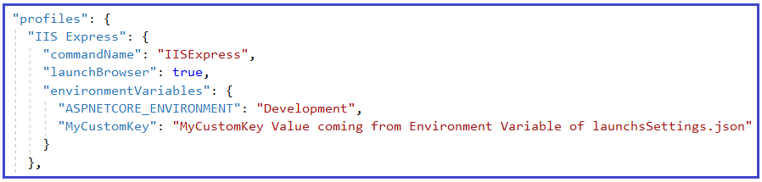
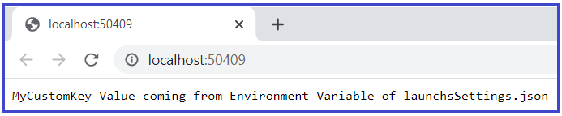
What are the Default Orders of reading the configuration sources?
The default orders in which the various configuration sources are read for the same key are as follows
appsettings.json,
appsettings.{Environment}.json here we use appsettings.development.json
User secrets
Environment variables
Command-line arguments
We already have MyCustomKey in two places i.e. appsettings.json and appsettings.development.json. Now add the same key as “MyCustomKey”: “MyCustomKey Value coming from Environment Variable of launchsSettings.json” in the IIS Express profile section of the launchSettings.json file as shown below.
With this change now run the application and it should display the value coming from the environment variable.

Slide 7
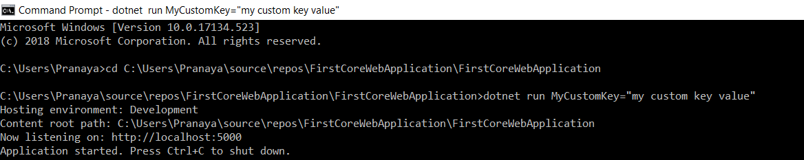

How to Pass Config value from Command Line in ASP.NET Core Application?
Now open the browser window and type the following URL

